Slide 1

Fast Algorithms for Querying and Mining Large Graphs
Hanghang Tong
Machine Learning Department
Carnegie Mellon University
htong@cs.cmu.edu
http://www.cs.cmu.edu/~htong

Slide 2
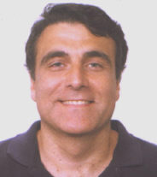

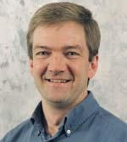
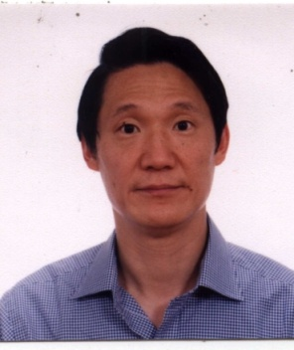
Thesis Committee
Christos Faloutsos
William Cohen
Jeff Schneider
Philip S. Yu

Slide 3

To Christos!

Slide 4
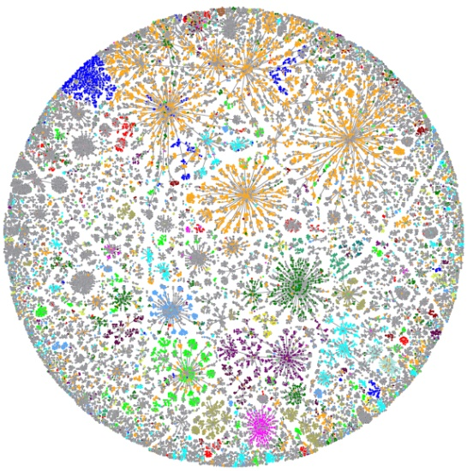
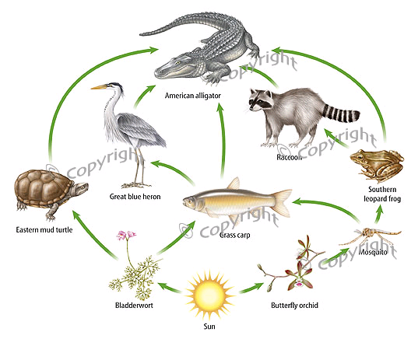
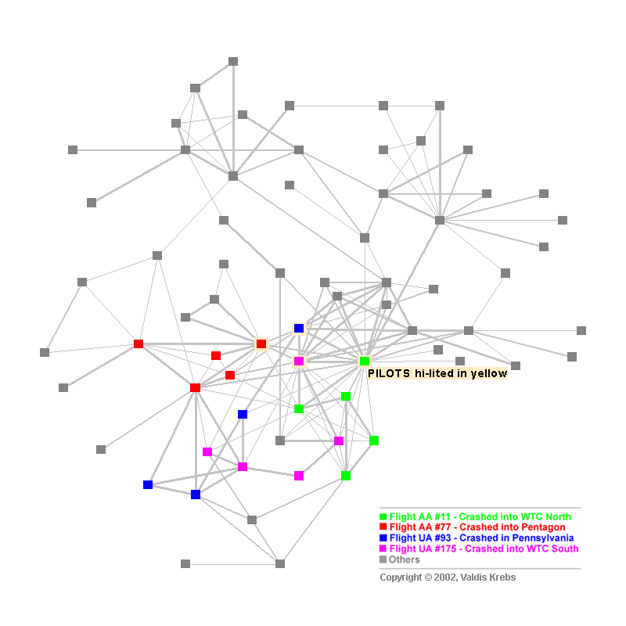
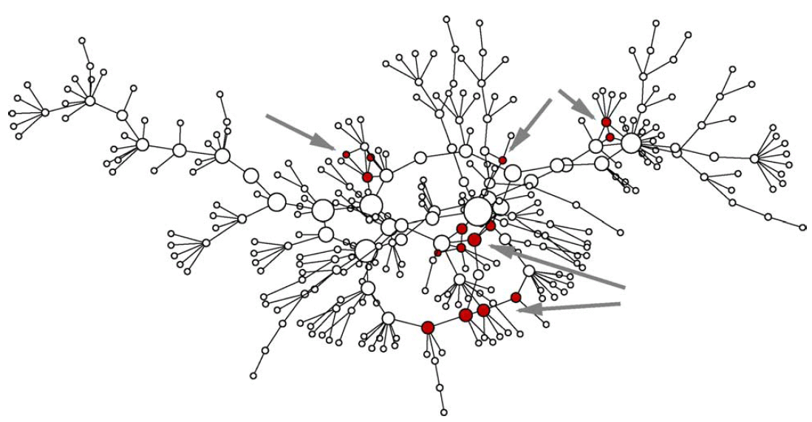
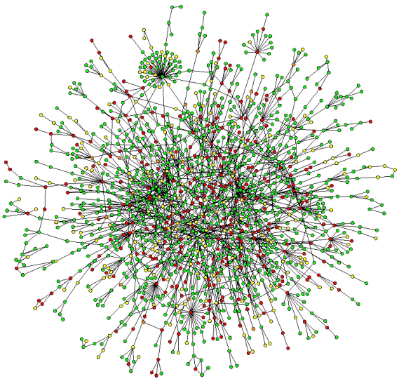
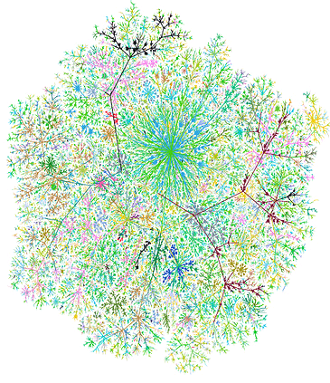
Graphs are everywhere!
-----
Why Do We Care?
Internet Map [Koren 2009]
Food Web [2007]
Terrorist Network
[Krebs 2002]
Social Network
[Newman 2005]
Protein Network
[Salthe 2004]
Web Graph
Notes:
Graph are everywhere. Such graphs have pose a wealth of fascinating research question, let me give you some examples

Slide 5
Research Theme
Help users to understand and utilize large graph-related data?

Slide 6
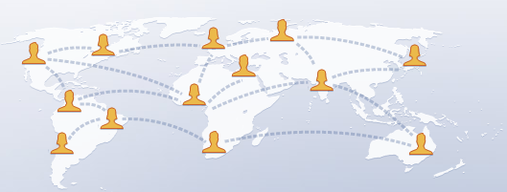





A1: Social Networks
Facebook (300m users, $10bn value, $500mn revenue)
MSN (240m users, 4.5pb); Myspace (110m users)
LinkedIn (50m users, $1bn value); Twitter (18m users)
How to help users explore such networks?
Notes:
Facebook: 300m (largest social network); 500mn revenue in 2009, 10bn values
Myspace: 110m+ users
http://www.web-strategist.com/blog/2008/01/09/social-network-stats-facebook-myspace-reunion-jan-2008/
http://www.reuters.com/article/technologyNews/idUSTRE58E7ZK20090916?feedType=RSS&feedName=technologyNews
Twitter: 18million http://www.emarketer.com/Article.aspx?R=1007271

Slide 7
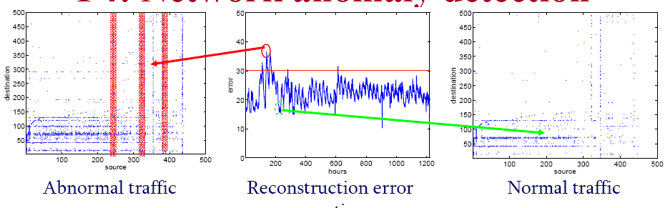
A2: Network Forensics [Sun+ 2007]
How to detect abnormal traffic?
Port scanning
DDoS
Normal Traffic
IP Destination
Recon. Error
IP Destination
IP Source
Time
IP Source

Slide 8
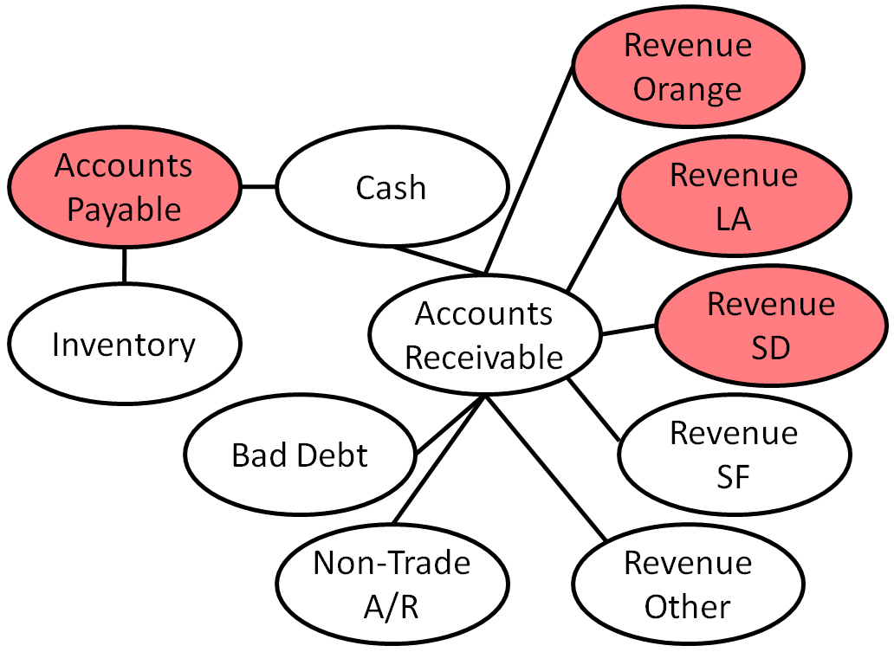

A3: Financial Fraud Detection [McGlohon+ 2009]
Given initial suspicions (red), how to find
misstated accounts ?
7.5% of U.S. adults lost money for financial fraud
50%+ US corporations lost >= $500,000 [Albrecht+ 2001]
e.g., Enron ($70bn)
Total cost of financial fraud: $1trillion [Ansari 2006]
Notes:
7.5 percent of U.S. adults lost money as a result of some sort of financial fraud in 2008 http://www.consumeraffairs.com/news04/2009/03/financial_breach.html
Global financial crisis to cost $4 trillion: IMF
http://en.infoanda.com/link.php?lh=A1UCAgEBDAgH
A 2005 study by Glass Lewis found that investors lost almost $ 1 trillion during 1999-2004 due to accountancy related frauds.
http://www.pafkiet.edu.pk/LinkClick.aspx?fileticket=M%2BR1WW9MzjA%3D&tabid=153&mid=1540

Slide 9

A4: Immunization
Footnote: SARS costs 700+ lives; $40+ Bn
How to select k `best’ nodes for immunization?
23
16
24
15
12
14
25
22
13
26
11
21
27
9
34
20
10
1
28
4
8
33
19
2
29
3
7
18
5
30
6
17
31
32
Notes:
http://en.wikipedia.org/wiki/Severe_acute_respiratory_syndrome
http://www.independent.co.uk/news/business/news/sars-costs-asia-11bn-and-the-bill-is-still-rising-594954.html
http://news.yahoo.com/s/ynews/20090428/bs_ynews/ynews_bs317

Slide 10






A5: Viral Marketing [Domingos+ 2001, Leskovec+ 2007]
0.6
0.9
0.8
0.5
0.3
0.2
0.1
How to select k ‘best’ customers
to be advertised?

Slide 11
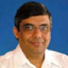
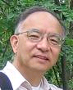
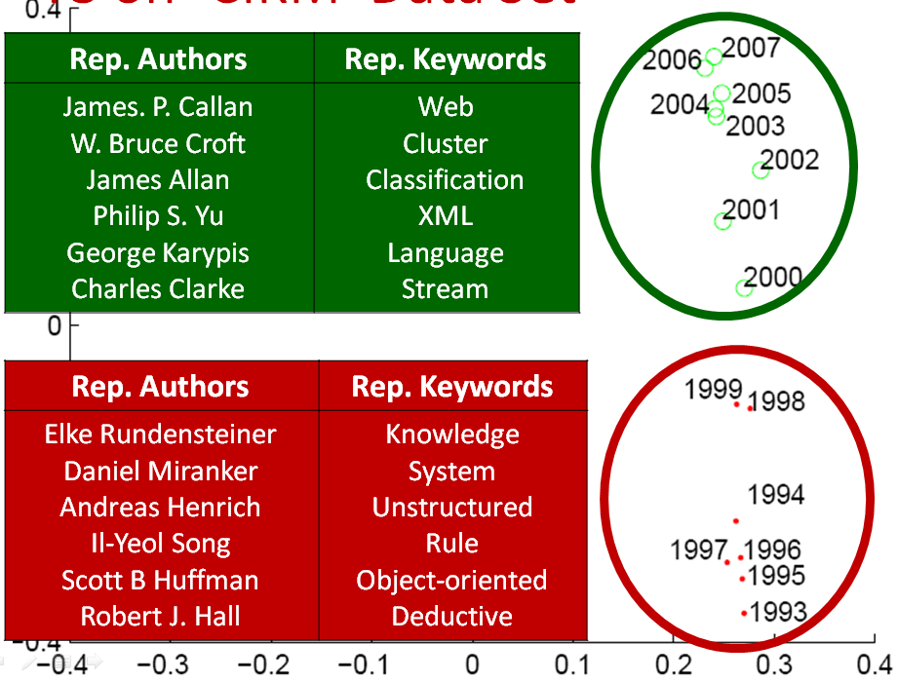
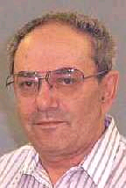
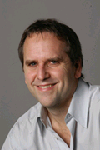
Thesis Work: (high level)
Given a large graph, we want to
+Task Q: Querying
+Task M: Mining
CePS on DBLP [Tong+ KDD 06]
T3 on CIKM [Tong+ CIKM 08]
Will return to this later…
Notes:
Our goal is to help the user to understand and utilize such graph data?
In this thesis, we mainly focus
Here is an example on querying large graphs. This is a so-called ceps for 4 researchers in data mining from dblp co-authorship network
On the right side is an example on mining large graphs, we can find two clusters for publication year for cikm conference proceedings and so we select representative authors/keywords as the interpretations for our findings.

Slide 12
Thesis Work (in detail)
Querying [Goal: query complex relationship]
Q.1. Find complex user-specific patterns;
Q.2. Proximity tracking;
Q.3. Answer all the above questions quickly.
Mining [Goal: find interesting patterns]
M.1. Immunization;
M.2. Spot anomalies;
M.3. Mining complex time-stamped events.
Notes:
More specifically, for both querying & mining, we focus on three sub-tasks respectively.
For querying, first we focus on how to

Slide 13

Thesis Work vs. Applications
App.s Tasks | A1 | A2 | A3 | A4 | A5
Q1
Q2
Q3
M1
M2
M3
Q1: Complex User-Specific Patterns
Q2: Proximity Tracking
Q3: Fast Proximity Computing
M1: Immunization
M2: Anomaly Detection
M3: Complex Time-Stamped Events
A1: Social Networks
A2: Network Forensics
A3: Financial Fraud
A4: Immunization
A5: Viral Marketing

Slide 14
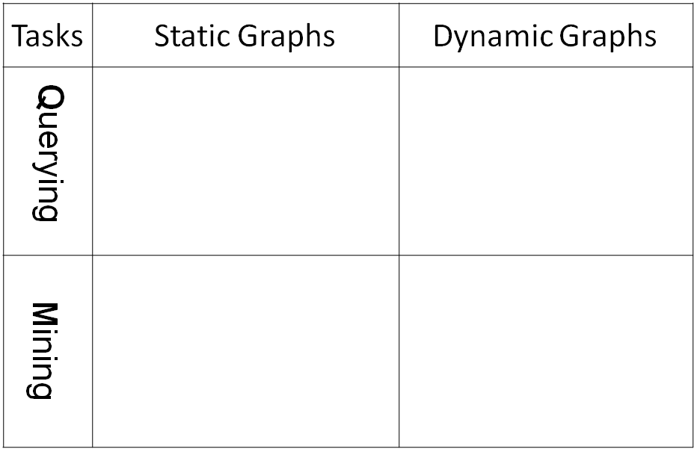
Thesis Overview
Q1
Q2
Q3
Q3
M1
M3
M2
M2
Notes:
And, here is how these questions map to our work, where green is the completed work, and red is future plan

Slide 15
Thesis Overview
CePS, iPoG, Basset
(KDD06, ICDM08, CIKM09)
pTrack/cTrack
(SDM08, SAM08)
Q1
Q2
FastProx (ICDM06,
KAIS07, KDD07 b, ICDM08)
FastProx
(SDM08, SAM08)
Q3
Q3
NetShield
(Submitted)
T3/MT3
(CIKM08)
M1
M3
Colibri-S
(KDD08)
Colibri-D
(KDD08)
M2
M2
Notes:
And, here is how these questions map to our work, where green is the completed work, and red is future plan

Slide 16
Foundations: Proximity Measurement
a.k.a Relevance, Closeness, ‘Similarity’…
Q: How close is A to B?

Slide 17
Random Walk with Restart [Tong+ ICDM 2006]
0.04
0.03
 | Node 4
Node 1 Node 2 Node 3 Node 4 Node 5 Node 6 Node 7 Node 8 Node 9 Node 10 Node 11 Node 12 | 0.13 0.10 0.13 0.22 0.13 0.05 0.05 0.08 0.04 0.03 0.04 0.02
10
0.10
9
12
0.13
2
0.08
0.02
1
8
0.13
11
3
0.04
4
0.05
6
5
0.13
7
0.05
Nearby nodes, higher scores
Ranking vector
More red, more relevant

Slide 18
Intuitions: Why RWR is Good Score?
Source
Target
3
4
5
12
14
20
1
2
13
15
6
7
8
9
10
11
Score (Red Path) =
(1-c) c⁶ x A(1,3) x A(3,4) x …. x A(14,20)
Penalty of length of path
Prob of traversing the path
Footnote: (1-c) is restart probability in RWR.

Slide 19
Intuitions: Why RWR is Good Score?
Source
Target
3
4
5
12
14
20
1
2
13
15
6
7
8
9
10
11
Prox (1, 20) = Score (Red Path) +
Score (Green Path) +
Score (Yellow Path) +
Score (Purple Path) + …
A high proximity means many short/high weighted paths

Slide 20
Thesis Overview
CePS, iPoG, Basset
(KDD06, ICDM08, CIKM09)
pTrack/cTrack
(SDM08, SAM08)
Q1
Q2
FastProx (ICDM06,
KAIS07, KDD07 b, ICDM08)
FastProx
(SDM08, SAM08)
Q3
Q3
NetShield
(Submitted)
T3/MT3
(CIKM08)
M1
M3
Colibri-S
(KDD08)
Colibri-D
(KDD08)
M2
M2
Notes:
And, here is how these questions map to our work, where green is the completed work, and red is future plan

Slide 21
Q1: Find Complex User-Specific Patterns
Q1.1. Center-Piece Subgraph Discovery,
e.g., master-mind criminal given some suspects X, Y and Z?
Q1.2 Interactive Querying (e.g. Negation)
e.g., find most similar conferences wrt KDD, but not like ICML?
Q1.3 Gateway Finder
e.g., who is the best expert to route it to in a customer-question center?
Notes:
In Q1. the goal is to ….. We have addressed three appliaticons in this categogry, i.e., ceps, bepm, and iterative querying

Slide 22
Q1.1 Center-Piece Subgraph Discovery [Tong+ KDD 06]
Input
Output
CePS Node
CePS
Original Graph
Q: How to find hub for the black nodes?
Red: Max (Prox(A, Red) x Prox(B, Red) x Prox(C, Red))
Notes:
In the first application, the ceps

Slide 23
CePS: Example (AND Query)
DBLP co-authorship network:
- 400,000 authors, 2,000,000 edges

Slide 24
K_SoftAND: Relaxation of AND
details
Disconnected
Communities
Noise
Asking AND query? ➔ No Answer!
Notes:
Another reason to motivate the k_softand query is that, in some situations, asking an and_query might be too restrictive, especially when the # of the queries is large, or there exist noise in the query set, like in the left figure; or the queries belongs to different remote/dis-connected communities, like in the right figure
In both examples, the algorithm will output no answer for AND query

Slide 25
CePS: 2 SoftAND
details
DB
Stat.
Notes:
This is CePS w/ 2-softand for the same querying authors. The result is quite different from before, which consists of …, reflecting …

Slide 26
Thesis Overview
CePS, iPoG, Basset
(KDD06, ICDM08, CIKM09)
pTrack/cTrack
(SDM08, SAM08)
Q1
Q2
FastProx (ICDM06,
KAIS07, KDD07 b, ICDM08)
FastProx
(SDM08, SAM08)
Q3
Q3
NetShield
(Submitted)
T3/MT3
(CIKM08)
M1
M3
Colibri-S
(KDD08)
Colibri-D
(KDD08)
M2
M2
Notes:
And, here is how these questions map to our work, where green is the completed work, and red is future plan

Slide 27
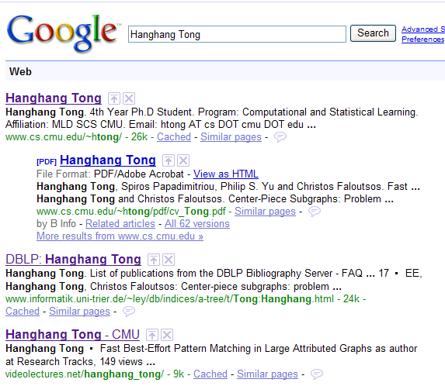
Q1.2: Interactive Querying
User Feedback
User Feedback
User Feedback
User Feedback

Slide 28
Q1.2 iPoG for Interactive Querying [Tong+ ICDM 08, CIKM 09]
Initial Results | No to `ICML’ | Yes to `SIGIR’
'ICDM' 'ICML' 'SDM' 'VLDB' 'ICDE' 'SIGMOD' 'NIPS' 'PKDD' 'IJCAI' 'PAKDD' | 'ICDM' 'SDM' 'PKDD' 'ICDE' 'VLDB' 'SIGMOD' 'PAKDD' 'CIKM' 'SIGIR' 'WWW' | 'SIGIR' 'TREC' 'CIKM' 'ECIR' 'CLEF' 'ICDM' 'JCDL' 'VLDB' 'ACL' 'ICDE'
two main sub-communities in KDD: DBs (green) vs. Stat (Red) | Negative feedback on ICML will exclude other stats confs (NIPS, IJCAI) | Positive feedback on SIGIR will bring more IR (brown) conferences.
what are most related conferences wrt KDD?
(DBLP author-conference bipartite graph)
Notes:
In the 3rd application of Q1, we want to incorporate some side information, such as, users’ feedback.
Again, let me skip the algorithm details and give you an example

Slide 29
Q1.2 iPoG for Interactive Querying [Tong+ ICDM 08, CIKM 09]
Initial Results | No to `ICML’ | Yes to `SIGIR’
'ICDM' 'ICML' 'SDM' 'VLDB' 'ICDE' 'SIGMOD' 'NIPS' 'PKDD' 'IJCAI' 'PAKDD' | 'ICDM' 'SDM' 'PKDD' 'ICDE' 'VLDB' 'SIGMOD' 'PAKDD' 'CIKM' 'SIGIR' 'WWW' | 'SIGIR' 'TREC' 'CIKM' 'ECIR' 'CLEF' 'ICDM' 'JCDL' 'VLDB' 'ACL' 'ICDE'
two main sub-communities in KDD: DBs (green) vs. ML/AI (Red) | Negative feedback on ICML will exclude other ML/AI conf.s (NIPS, IJCAI) | Positive feedback on SIGIR will bring more IR (brown) conferences.
what are most related conferences wrt KDD?
(DBLP author-conference bipartite graph)
Notes:
In the 3rd application of Q1, we want to incorporate some side information, such as, users’ feedback.
Again, let me skip the algorithm details and give you an example

Slide 30
Q1.2 iPoG for Interactive Querying [Tong+ ICDM 08, CIKM 09]
Initial Results | No to `ICML’ | Yes to `SIGIR’
'ICDM' 'ICML' 'SDM' 'VLDB' 'ICDE' 'SIGMOD' 'NIPS' 'PKDD' 'IJCAI' 'PAKDD' | 'ICDM' 'SDM' 'PKDD' 'ICDE' 'VLDB' 'SIGMOD' 'PAKDD' 'CIKM' 'SIGIR' 'WWW' | 'SIGIR' 'TREC' 'CIKM' 'ECIR' 'CLEF' 'ICDM' 'JCDL' 'VLDB' 'ACL' 'ICDE'
two main sub-communities in KDD: DBs (green) vs. ML/AI (Red) | Negative feedback on ICML will exclude other ML/AI conf.s (NIPS, IJCAI) | Positive feedback on SIGIR will bring more IR (brown) conferences.
what are most related conferences wrt KDD?
(DBLP author-conference bipartite graph)
Notes:
In the 3rd application of Q1, we want to incorporate some side information, such as, users’ feedback.
Again, let me skip the algorithm details and give you an example

Slide 31
Thesis Overview
CePS, iPoG, Basset
(KDD06, ICDM08, CIKM09)
pTrack/cTrack
(SDM08, SAM08)
Q1
Q2
FastProx (ICDM06,
KAIS07, KDD07 b, ICDM08)
FastProx
(SDM08, SAM08)
Q3
Q3
NetShield
(Submitted)
T3/MT3
(CIKM08)
M1
M3
Colibri-S
(KDD08)
Colibri-D
(KDD08)
M2
M2
Notes:
And, here is how these questions map to our work, where green is the completed work, and red is future plan

Slide 32
Q1.3 Gateway Finder
Find `best’ gateway between a source (s) and a target (t)
`best’ gateway = a set of nodes which are most important wrt connecting source (s) to target (t)
Applications: skill search; question router etc
Graph
Image
Kalman
FFT
Wavelets
Wavelets
Jon
Bob
Tony
Jack
Smith
Source
Gateway
Target
Notes:
There are two sub-questions: (1) how to define a good gatewayness score for a subset of nodes; (2) how to find a subset of nodes with highest gatewayness score

Slide 33
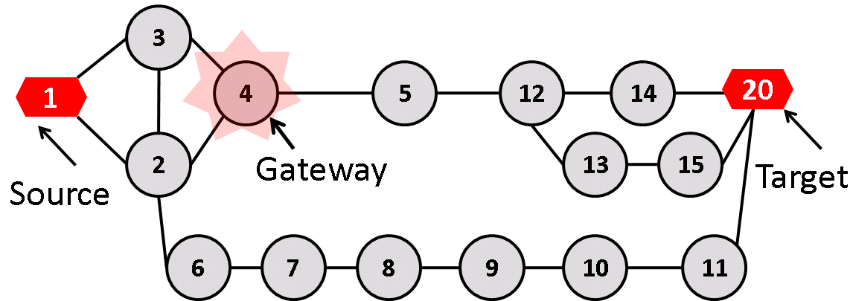
Q1.3: ‘Gatewayness’ score
~
g(s,t, I) = Prox (s→t) – Prox (s→t)
Proximity from s to t on the original graph
Proximity from s to t wo/ subset of nodes I
~
Prox (1→20) = 0.05
Prox (1→20) = 0.01
g(1,20, 4) =0.05 -0.01=0.04
Notes:
Say the intuition of such definitions

Slide 34
Intuition of g(s, t, I)
g(s, t, I) accounts for all paths from s to t, which go through set I
Source
Target
3
4
5
12
14
20
1
2
Gateway
13
15
6
7
8
9
10
11
g(1, 20, 4) accounts for red path, yellow path, etc

Slide 35
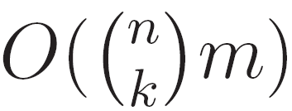
Q1.3: Find `Best’ Gateway (a subset of nodes with highest `gatewayness’)
Straight-forward method:
C1: Each time works on a different graph
C2: Combinatorial enumeration
Example:
A graph with 1,000,000 nodes
compute 1 proximity score: 0.001 seconds
Then, it takes 2.6 x 10¹⁷ years to find best-5 gateway
Footnote: the age of universe 1.4 x 10¹⁴ years

Slide 36
Q1.3: Find `Best’ Gateway (Proposed Basset to rescue)
Theorem: (Tong+ 2009)
(1) g(s,t,I) = Prox(t,I) x Prox(I,I)⁻¹ x Prox(I,s)
(2) g(s,t,I) is sub-modular with I
(3) Basset is near-optimal
(4) Basset is O(nk⁴)
Example:
A graph with 1,000,000 nodes
Basset takes 10 seconds to find best-5 gateway
… as apposed to 2.6 x 10¹⁷ years
Footnote: near-optimal means g(s, t, I ^{basset}) >= (1-1/e) g(s, t, I ^{opt})

Slide 37
Basset on Zachary's Karate Graph
23
16
24
15
12
14
25
22
13
26
11
21
27
9
34
20
10
1
28
4
8
33
19
2
29
3
7
18
5
30
6
17
31
32
Node: Members in Karate Club; Edge: Friendship

Slide 38
Thesis Overview
CePS, iPoG, Basset
(KDD06, ICDM08, CIKM09)
pTrack/cTrack
(SDM08, SAM08)
Q1
Q2
FastProx (ICDM06,
KAIS07, KDD07 b, ICDM08)
FastProx
(SDM08, SAM08)
Q3
Q3
NetShield
(Submitted)
T3/MT3
(CIKM08)
M1
M3
Colibri-S
(KDD08)
Colibri-D
(KDD08)
M2
M2
Notes:
And, here is how these questions map to our work, where green is the completed work, and red is future plan

Slide 39
Q2.2 pTrack: Challenge [Tong+ SDM 08]
Observations (CePS, iPoG, Basset…)
All for static graphs
Proximity: main tool
Graphs are evolving over time!
New nodes/edges show up;
Existing nodes/edges die out;
Edge weights change…
Q: How close is Philip to DBs over years?
A: Track proximity, incrementally!
Notes:
For the next application (proximity track), the motivation is as follows
However, many real graphs,
One natural way to address this problem is to track the proximity of interest efficiently over time

Slide 40
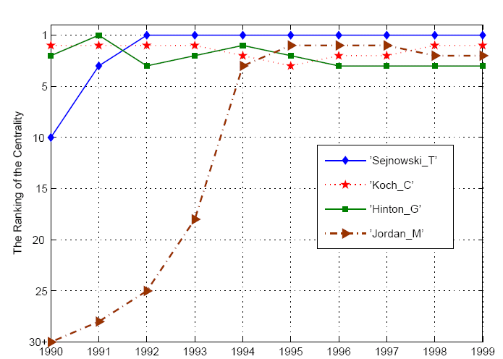
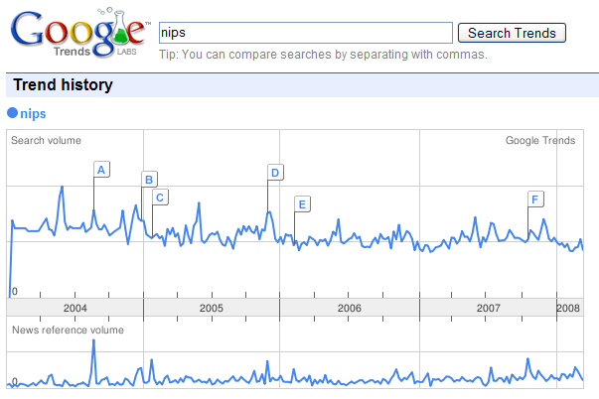
pTrack: Trend analysis on graph level
T. Sejnowski
Rank of Influence
G.Hinton
C. Koch
M. Jordan
Year
Notes:
Let me give you an example, which is one major conference in stat. learning, neural network.
Arrow direction

Slide 41
pTrack: Problem Definitions
[Given]
a large, skewed time-evolving bipartite graphs,
the query nodes of interest
[Track]
(1) top-k most related nodes for each query node at each time step t;
(2) the proximity score (or rank of proximity) between any two query nodes at each time step t
Notes:
Can go

Slide 42
pTrack: Philip S. Yu’s Top-5 conferences up to each year
ICDE ICDCS SIGMETRICS PDIS VLDB | CIKM ICDCS ICDE SIGMETRICS ICMCS | KDD SIGMOD ICDM CIKM ICDCS | ICDM KDD ICDE SDM VLDB
1992 | 1997 | 2002 | 2007
DBLP: (Au. x Conf.)
- 400k authors,
- 3.5k conferences
- 20 years
Databases
Performance
Distributed Sys.
Databases
Data Mining
Notes:
While DBs is still one of his major research focus, data mining becomes a strong research focus.
Can go

Slide 43
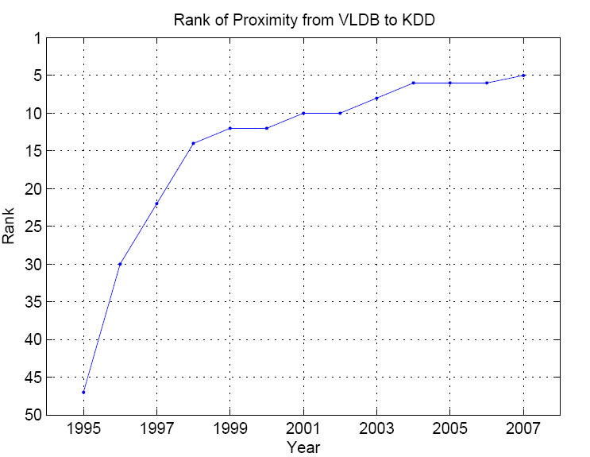
KDD’s Rank wrt. VLDB over years
John
VLDB
Tom
Bob
KDD
Prox. Rank
(Closer)
Carl
ICML
Van
Roy
RECOMB
…….
Data Mining and Databases
are getting closer & closer
Year
Notes:
Can go

Slide 44
Q2: pTrack on Bipartite Graphs
Computational Challenges (assuming )
Iterative method O(m)
Straight-forward update
Example
NetFlix (2.6m users x 18k movies, 100m ratings)
Both need >1hr

Slide 45
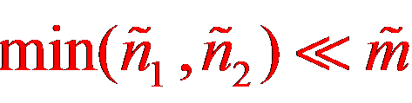
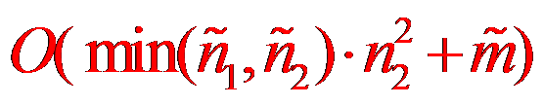
Q2: pTrack on Bipartite Graphs
Observation #1
n₁ authors; n₂ conferences;
n₁ >> n₂
e.g., 400k authors, 3.5k conf.s in DBLP
Observation #2
m edges changed, (n₁ authors, n₂ conf.s)
rank of update = = update
Proposed algorithm: Fast-Update
KDD
Conferences
Authors
~
~
~
Theorem: (Tong+ 2008)
(1) Fast-Update has no quality loss
(2) Fast-Update is

Slide 46
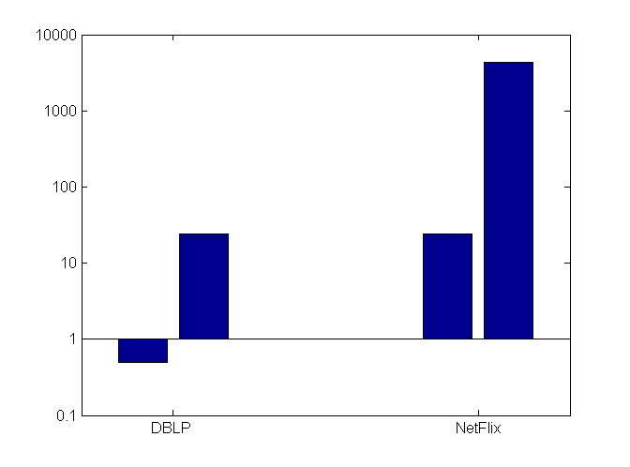
Q2: Speed Comparison
log(Time)
(Seconds)
176x speedup
40x speedup
Our method
Our method
46
Data Sets

Slide 47
Thesis Overview
CePS, iPoG, Basset
(KDD06, ICDM08, CIKM09)
pTrack/cTrack
(SDM08, SAM08)
Q1
Q2
FastProx (ICDM06,
KAIS07, KDD07 b, ICDM08)
FastProx
(SDM08, SAM08)
Q3
Q3
NetShield
(Submitted)
T3/MT3
(CIKM08)
M1
M3
Colibri-S
(KDD08)
Colibri-D
(KDD08)
M2
M2
Notes:
And, here is how these questions map to our work, where green is the completed work, and red is future plan

Slide 48
Computing RWR
Ranking vector
(Normalized)
Adjacency matrix
Restart p
Starting vector
9
10
1
12
2
1
8
3
11
4
5
6
7
n x 1
n x n
n x 1
Footnote: Maxwell Equation for Web [Chakrabarti]
Notes:
So far it’s good. Now, let’s turn to the computational issue of rwr. (Well, here is the definition of rwr. (Given a query node i, how can we compute its relevance score with every other node j, in other words, how can we can the ranking vector r_i;)
OK, here is the definition of random walk with restart, such that r is n x 1, where n is the # of the nodes in the graph, ranking vector, W-tuda is n x n normalized adjacent matrix, e_i is n x 1 starting vector, and 1-c is the restarting prob. by setting the different starting vector, we can get the different ranking vector for different query node (For example, setting the 4^th element of e_i to be 1 and 0 for all others, we can get the ranking vector query node 4.)
So, given a query node, or equivalently given a starting vector, how can we solve this linear system?

Slide 49
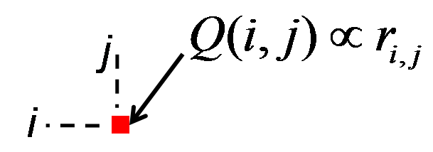
Computing RWR
-1
= - c x
~
Q
I
W
How to get (elements) of Q?
~
Footnote: 1-c restart prob; W normalized adjacency matrix

Slide 50
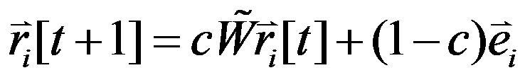
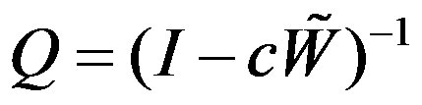
Computing RWR
OntheFly
No Pre-Computation;
Light Storage Cost (W)
Slow On-Line Response: O(m x Iter)
Pre-Compute
Fast On-Line Response
Prohibitive Pre-Compute Cost: O(n³)
Prohibitive Storage Cost: O(n²)
~
Notes:
This explanation also suggests two straight-forward ways to compute rwr, either by on-line iterative procedure or to pre-compute the Q matrix.
However, neither of them is practical, they either require prehibitive off-line cost, or is slow for on-line reponse

Slide 51

Q: How to Balance?
On-line
Off-line
Goal: Efficiently get (elements) of

Slide 52
B_Lin: Basic Idea [Tong+ ICDM 2006]
Find Community
2
2
1
1
3
3
4
4
10
9
10
0.04
9
0.03
12
10
12
0.10
9
2
2
0.13
0.08
12
8
2
1
8
0.02
1
11
8
3
11
1
3
3
0.13
11
0.04
4
4
4
6
6
0.05
5
6
5
5
0.13
7
0.05
7
7
10
9
10
Combine
9
12
2
12
2
8
1
8
1
11
3
11
3
4
4
6
Fix the remaining
5
6
5
7
7

Slide 53
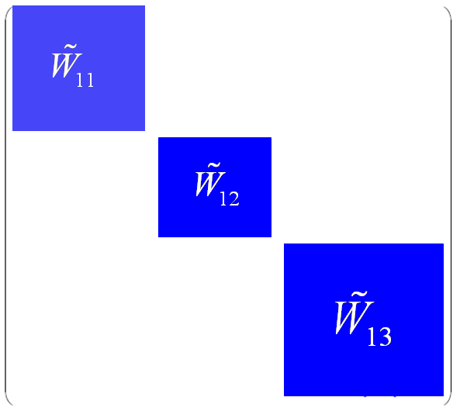
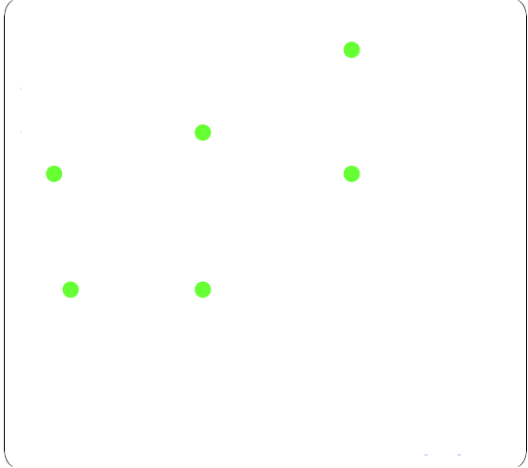



B_Lin: details
details
+
~
=
W
~
+
~
~
W ₁: within community
Cross community

Slide 54
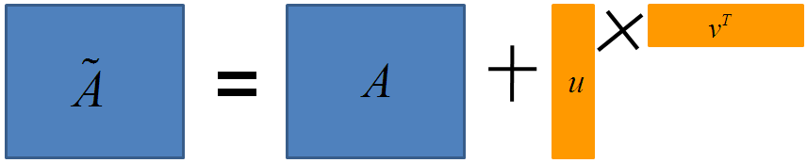
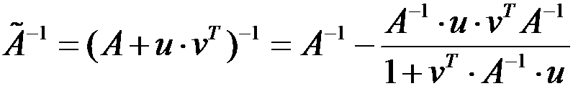
B_Lin: details
details
-1
-1
~
~
~
I – c
W
~
W₁
I – c – cUSV
Easy to be inverted
LRA difference
Sherman–Morrison Lemma!
If
Then

Slide 55
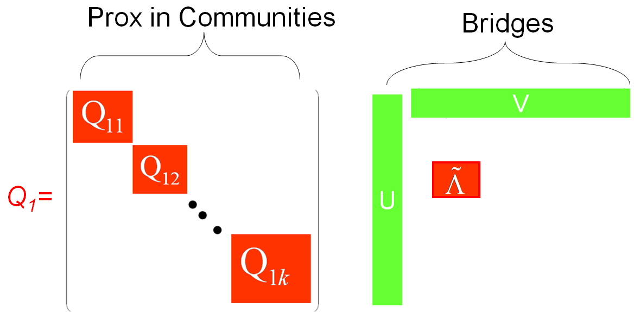
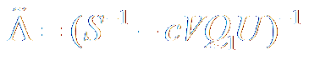
B_Lin: Pre-Compute Stage
Q: Efficiently compute and store Q
A: A few small, instead of ONE BIG, matrices inversions
Footnote: Q₁=(I-cW₁)⁻¹

Slide 56
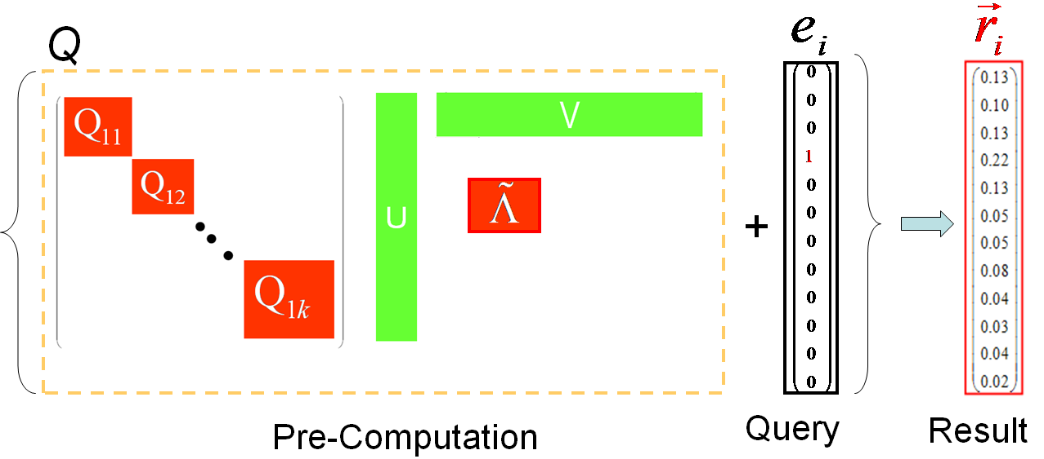
B_Lin: On-Line Stage
Q: Efficiently recover one column of Q
A: A few, instead of MANY, matrix-vector multiplications

Slide 57
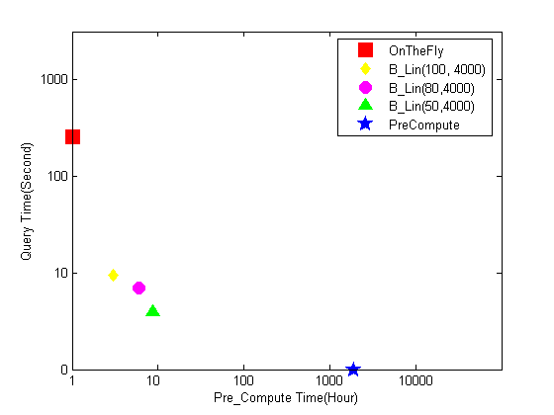
Query Time vs. Pre-Compute Time
Log Query Time
Quality: 90%+
On-line:
Up to 150x speedup
Pre-computation:
Two orders saving
Our Results
Log Pre-compute Time

Slide 58
More on Scalability Issues for Querying (the spectrum of ``FastProx’’)
B_Lin: one large linear system
[Tong+ ICDM06, KAIS08]
BB_Lin: the intrinsic complexity is small
[Tong+ KAIS08]
FastUpdate: time-evolving linear system
[Tong+ SDM08, SAM08]
FastAllDAP: multiple linear systems
[Tong+ KDD07 a]
Fast-iPoG: dealing w/ on-line feedback
[Tong+ ICDM 2008, Tong+ CIKM09]
Notes:
Finally, in the case that users’ feedback is obtained on-line, how can we efficiently incorporate such kind of SI.

Slide 59
Thesis Overview
CePS, iPoG, Basset
(KDD06, ICDM08, CIKM09)
pTrack/cTrack
(SDM08, SAM08)
Q1
Q2
FastProx (ICDM06,
KAIS07, KDD07 b, ICDM08)
FastProx
(SDM08, SAM08)
Q3
Q3
NetShield
(Submitted)
T3/MT3
(CIKM08)
M1
M3
Colibri-S
(KDD08)
Colibri-D
(KDD08)
M2
M2
Notes:
And, here is how these questions map to our work, where green is the completed work, and red is future plan

Slide 60
M1: Immunization
How to select best-k nodes to immunize?
23
16
24
15
12
14
25
22
13
26
11
21
27
9
34
20
10
1
28
4
8
33
19
2
29
3
7
18
5
30
6
17
31
32
Notes:
http://en.wikipedia.org/wiki/Severe_acute_respiratory_syndrome
http://www.independent.co.uk/news/business/news/sars-costs-asia-11bn-and-the-bill-is-still-rising-594954.html
http://news.yahoo.com/s/ynews/20090428/bs_ynews/ynews_bs317

Slide 61
M1: Background [Chakrabarti+ 2008]
‘Flu’ like: Susceptible-Infectious-Susceptible
Virus ‘strength’ s= β/δ
Healthy
Prob. δ
N2
Prob. β
N1
N
Prob. β
Infected
N3
if strength s = β / δ < τ = 1/ λ_{1,A;}
an epidemic can not happen

Slide 62
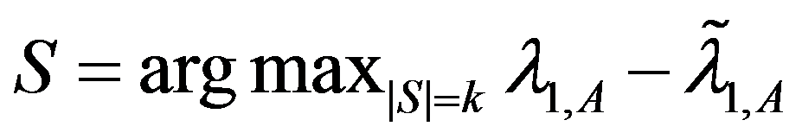
M1: Optimal Method
Select k nodes, whose absence creates the largest drop in λ_{1,A}
9
9
9
9
10
10
1
1
4
4
8
8
2
2
3
7
3
7
5
5
6
6
~
Original Graph: λ_{1,A}
Without {2, 6}: λ_{1,A}

Slide 63
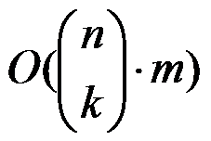
M1: Optimal Method
Select k nodes, whose absence creates the largest drop in λ_{1,A}
But, we need in time
Example:
1,000 nodes, with 10,000 edges
It takes 0.01 seconds to compute λ
It takes 2,615 years to find best-5 nodes !
Leading eigenvalue
wo/ subset of nodes S

Slide 64
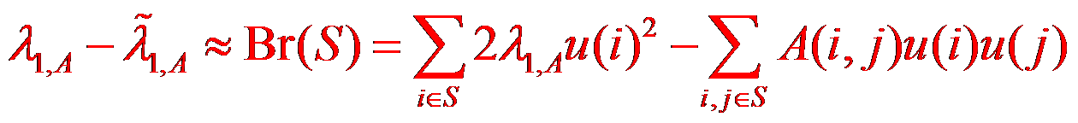
M1: Netshield to Rescue
Theorem: (Tong+ 2009)
(1)
6
A
u
u
1
5
1
7
1
8
1
= λ_{1,A}X
14
10
13
10
2
15
10
16
10
1
1
1
u(i): eigen-score
1
1
9
1
1
1
3
4
11
1
12

Slide 65
M1: Netshield to Rescue (Intuition)
Theorem: (Tong+ 2009)
(1)
find a set of nodes S, which
(1) each has high eigen-scores
(2) diverse among themselves
6
6
6
1
1
1
5
5
5
1
1
1
1
1
7
1
8
7
7
8
1
8
1
1
14
14
14
10
10
10
13
13
13
10
10
10
10
10
15
10
16
15
15
16
2
16
10
2
2
10
10
1
1
1
1
1
1
1
1
1
1
1
1
1
9
1
1
9
9
1
1
1
1
1
1
1
1
1
1
1
3
4
11
1
12
3
3
4
4
11
11
12
12

Slide 66
M1: Netshield to Rescue
Theorem: (Tong+ 2009)
(1)
(2) Br(S) is sub-modular
(3) Netshield is near-optimal (wrt max Br(S))
(4) Netshield is O(nk²+m)
Example:
1,000 nodes, with 10,000 edges
Netshield takes < 0.1 seconds to find best-5 nodes !
… as apposed to 2,615 years
Footnote: near-optimal means Br(S ^{Netshield}) >= (1-1/e) Br(S ^{Opt})

Slide 67
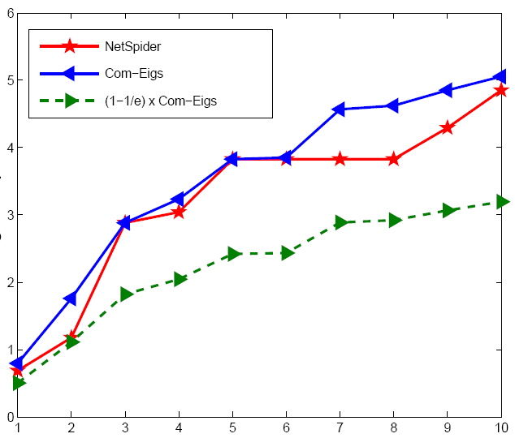
M2: Quality of Netshield
(better)
Optimal
Netshield
Eig-Drop
(1-1/e) x Optimal
k

Slide 68
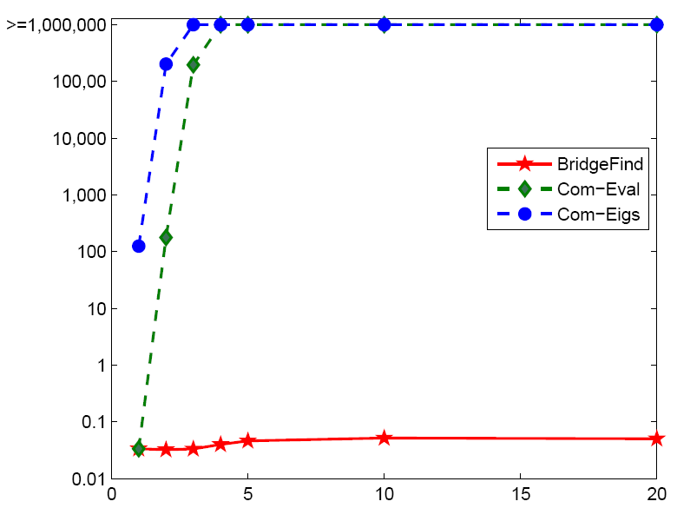
M1: Speed of Netshield
> 10 days
(better)
Time
NIPS
co-authorship
Network
Netshield
0.1 second
k

Slide 69
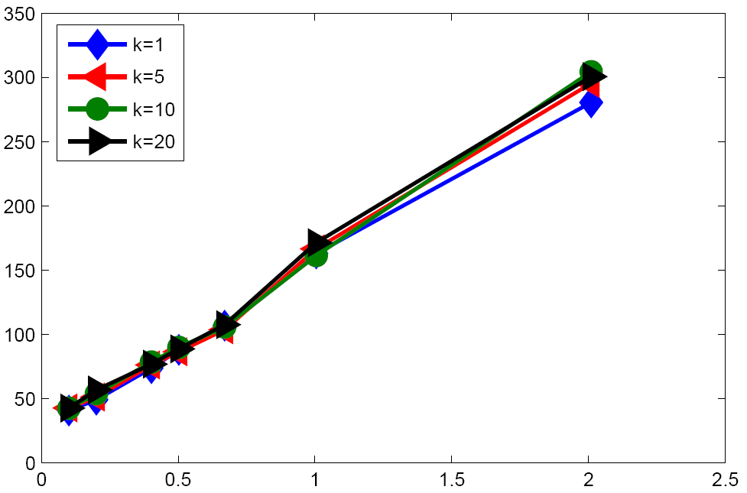
Scalability of Netshield
(better)
Time
# of edges
X 10⁸

Slide 70
Thesis Overview
CePS, iPoG, Basset
(KDD06, ICDM08, CIKM09)
pTrack/cTrack
(SDM08, SAM08)
Q1
Q2
FastProx (ICDM06,
KAIS07, KDD07 b, ICDM08)
FastProx
(SDM08, SAM08)
Q3
Q3
NetShield
(Submitted)
T3/MT3
(CIKM08)
M1
M3
Colibri-S
(KDD08)
Colibri-D
(KDD08)
M2
M2
Notes:
And, here is how these questions map to our work, where green is the completed work, and red is future plan

Slide 71
Motivation [Tong+ KDD 08 b]
Q: How to find patterns from a large graph?
e.g., communities, anomalies, etc.
A: Low-Rank Approximation (LRA) for adjacency matrix of the graph.
A
L
X
M
X
R
~
~
Notes:
For the task of mining, the goal is to find
One powerful tool for finding such patterns is low rank approximation for the adjacency matrix of the graph. That is, we want to approximate the adjacency matrix A by the multiplication of three (low rank) matrices: L M and R.

Slide 72
LRA for Graph Mining
Conference
John
1 | 1 | 0 | 0
1 | 1 | 0 | 0
1 | 1 | 0 | 0
0 | 1 | 1 | 1
0 | 0 | 1 | 1
0 | 0 | 1 | 1
ICDM
Tom
Bob
KDD
Author
Carl
ISMB
Van
Roy
RECOMB
Author
Conference
Adjacency matrix: A
Notes:
For example, given an author-conference graph, we can write down its adjacency matrix A, where rows are authors and columns are conferences.

Slide 73
LRA for Graph Mining: Communities
R: Conf. Group Matrix
John
Adj. matrix: A
ICDM
X
X
Tom
KDD
~
Bob
~
Carl
M: Group-Group
Interaction Matrix
ISMB
Van
Roy
RECOMB
L: author group matrix
Author
Conf.
Notes:
More specifically, the left matrix L is often a good indicator for row cluster membership, For example, in this illustrative author-conference bipartite graph, we can use L to identify two clusters for authors. And similarly, the right matrix R is often a good indicator for column cluster membership, - the clusters for conferences. And the middle matrix M indicates the interaction between the row cluster and column cluster.

Slide 74
LRA for Graph Mining: Anomalies
John
Adj. matrix: A
L
M
R
ICDM
X
X
Tom
KDD
~
Bob
~
Carl
ISMB
Van
Roy
RECOMB
Author
Conf.
Recon. error is high
→ ‘Carl’ is abnormal
Notes:
On the other hand, a significant deviation from such low rank structure ,- the high reconstruction error, is often a good indicator for anomaly on graphs.
For example, here, we can say Carl is abnormal since the reconstruction error for carl is high.

Slide 75
Challenges: How to Get (L, M, R)?
Efficiently
both time and space
Intuitively
easy for interpretation
Dynamically
track patterns over time
None of existing methods fully meets
our wish list!
Notes:
So, the question is how to get these three matrices.
In our work, we main focus on three aspects. First…
Despite the fact that there are a lot of existing methods for lra in the literature, none of them can fully meet all these three requirements.
Let me give you two examples.

Slide 76
Why Not SVD and CUR/CMD?
SVD (Optimal in L₂ and L_{F} )
Efficiency
Time:
Space: (L, R) are dense
Interpretation
Linear Combination of many columns
Dynamic: Not Easy
CUR/CMD (Example-based)
Efficiency
Better than SVD
Redundancy in L
Interpretation
Actual Columns from A xxxx
Dynamic: Not Easy

Slide 77
Solutions: Colibri [Tong+ KDD 08 b]
Colibri-S: for static graphs
Basic idea: remove linear redundancy
Colibri-D: for dynamic graphs
Basic idea: leverage smoothness over time
Theorem: (Tong+ 2008)
(1) Colibri = CUR/CMD in accuracy
(2) Colibri <= CUR/CMD in time
(3) Colibri <= CUR/CMD in space
Notes:
Our solution is the family of colibri methods

Slide 78
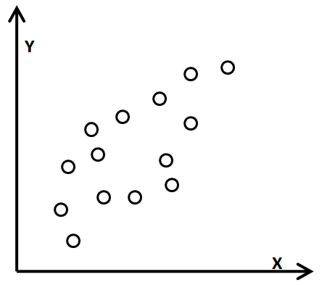
A Pictorial Comparison (static graphs)
1
ICML
Y: William Cohen
Philip
1
3
William
1
SIGMOD
……
X: Philip Yu
Each dot is a conference

Slide 79
A Pictorial Comparison: SVD
Y: William Cohen
2nd singular vector
1st singular vector
X: Philip Yu
Each dot is a conference

Slide 80
A Pictorial Comparison: CUR [Drineas+ 2005]
Y: William Cohen
2x
3x
2x
4x
2x
1x
X: Philip Yu
Each dot is a conference

Slide 81
A Pictorial Comparison: CMD [Sun+ 2007]
Y: William Cohen
X: Philip Yu
Each dot is a conference

Slide 82
A Pictorial Comparison: Colibri-S [Tong+ 2008]
Y: William Cohen
X: Philip Yu
Each dot is a conference

Slide 83
Comparison SVD, CUR vs. Colibri
details
s Wish List | SVD [Golub+ 1989] | CUR [Drineas+ 2005] | Colibri [Tong+ 2008]
Efficiency
Interpretation
Dynamics

Slide 84
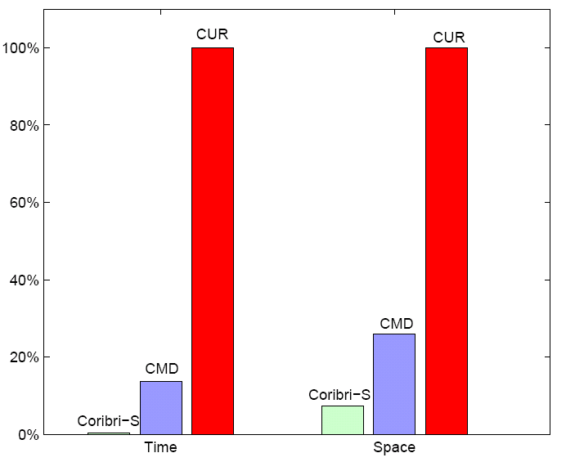
Performance of Colibri-S
SVD
SVD
CUR
CUR
Accuracy
Same 91%+
Time
12x of CMD
28x of CUR
Space
~1/3 of CMD
~10% of CUR
CMD
CMD
Ours
Ours
Time
Space
Notes:
CMD is an improved version of cur.
Both cur and cmn are special case of colibri-S
We do not present the result by svd, since for the same reconstruction accuracy, svd needs more time & space than cur

Slide 85
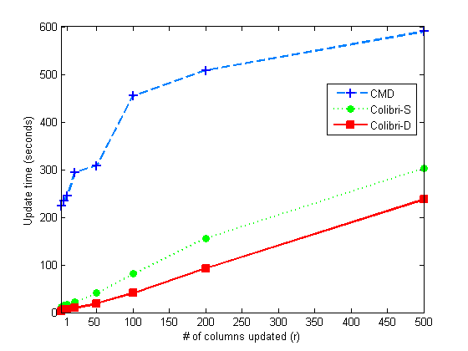
Performance of Colibri-D
Time
CMD
(Prior Best Method)
Network traffic
- 21,837 nodes
- 1,220 hours
- 22,800 edge/hr
Colibri-S
Colibri-D
Accuracy
- Same 93%+
# of changed cols
Colibri-D achieves up to 112x speedup
Notes:
Which is the prior best method for dynamic graphs

Slide 86
Thesis Overview
CePS, iPoG, Basset
(KDD06, ICDM08, CIKM09)
pTrack/cTrack
(SDM08, SAM08)
Q1
Q2
FastProx (ICDM06,
KAIS07, KDD07 b, ICDM08)
FastProx
(SDM08, SAM08)
Q3
Q3
NetShield
(Submitted)
T3/MT3
(CIKM08)
M1
M3
Colibri-S
(KDD08)
Colibri-D
(KDD08)
M2
M2
Notes:
And, here is how these questions map to our work, where green is the completed work, and red is future plan

Slide 87
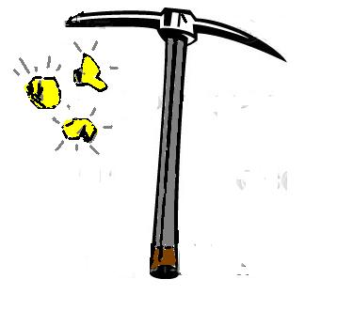
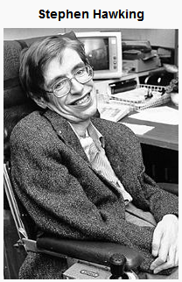
M3: How to mine complex
time-stamped events
[Tong+ CIKM 08]
What is time?
(a data miner’s answer, not Hawking’s)

Slide 88
A Motivating Example: Inputs
Time | Event(e.g., Session) | Entity
Oct. 26 | Link Analysis | Tom, Bob
 | Clustering | Bob, Alan
Oct. 27 | Classification | Bob, Alan
 | Anomaly Detection | Alan, Beck
Oct. 28 | Party | Beck, Dan
Oct. 29 | Web Search | Dan, Jack
 | Advertising | Jack, Peter
Oct. 30 | Enterprise Search | Jack, Peter
Oct. 31 | Q & A | Peter, Smith

Slide 89

A Motivating Example: Inputs
Time | Event(e.g., Session) | Entity
Oct. 26 | Link Analysis | Tom, Bob
 | Clustering | Bob, Alan
Oct. 27 | Classification | Bob, Alan
 | Anomaly Detection | Alan, Beck
Oct. 28 | Party | Beck, Dan
Oct. 29 | Web Search | Dan, Jack
 | Advertising | Jack, Peter
Oct. 30 | Enterprise Search | Jack, Peter
Oct. 31 | Q & A | Peter, Smith
DM
Party
IR

Slide 90
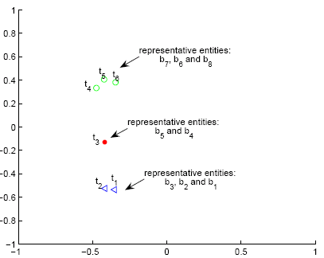
A Motivating Example: Outputs
Time Cluster,
rep. entities: b₇,b₆, b₈
Jack
Time Cluster
Rep. Entities:
``Jack’’, ``Peter’’, ``Smith’’
Oct. 30
Oct. 30
Oct. 29
Abnormal Time
Rep. Entities:
``Beck’’ , ``Dan’’
Oct. 28
Oct. 26
Time Cluster
Rep. Entities:
``Tom’’, ``Bob’’, ``Alan’’
Oct. 27

Slide 91
Problem Definitions (How to mine complex time-stamped events?)
Given data sets collected at different time stamps;
We want to find
+1: Time clusters
+2: Abnormal time stamps
+3: Interpretations
+4: Right time granularity
Our Solutions
T3
MT3
Notes:
So, formally,

Slide 92
Data Sets
CIKM: from CIKM proceedings
Time: Publication year (1993-2007, 15)
Event: Paper-published (952)
Entities: Author (1895) & Session (279)
Attribute: Keyword (158)
DeviceScan: from MIT Reality Mining
Time: the day scanning happened (1/1/2004-5/5/2005, 294)
Event: blue tooth device scanning person (114, 046)
Entities: Device (103) & Person (97)
Attribute: N/A

Slide 93

T3 on `CIKM’ Data Set
Rep. Authors | Rep. Keywords
James. P. Callan W. Bruce Croft James Allan Philip S. Yu George Karypis Charles Clarke | Web Cluster Classification XML Language Stream
Rep. Authors | Rep. Keywords
Elke Rundensteiner Daniel Miranker Andreas Henrich Il-Yeol Song Scott B Huffman Robert J. Hall | Knowledge System Unstructured Rule Object-oriented Deductive

Slide 94


MT3 on `DeviceScan’ Data Set
Apr. 2004 is anomaly
(spring break)
Work day
Weekend
+ holiday
Aggregate by Day
Aggregate by Month
Notes:
Why Apr. 2004 is abnormal? It is within the semester, but a lot of holidays (such as spring break), according to mit academic calendar

Slide 95
Thesis Overview
CePS, iPoG, Basset
(KDD06, ICDM08, CIKM09)
pTrack/cTrack
(SDM08, SAM08)
Q1
Q2
FastProx (ICDM06,
KAIS07, KDD07 b, ICDM08)
FastProx
(SDM08, SAM08)
Q3
Q3
NetShield
(Submitted)
T3/MT3
(CIKM08)
M1
M3
Colibri-S
(KDD08)
Colibri-D
(KDD08)
M2
M2
Notes:
And, here is how these questions map to our work, where green is the completed work, and red is future plan

Slide 96
What is Next?
Plans Goals | Step 1 (thesis) | Step 2 (medium term) | Step 3 (long term)
G1 Querying | Chapter 2-6 | Recommendation Interpretable Q | Querying rich data
G2 Mining | Chapter 7-9 | Immunization Interpretable M | Mining rich data
G3 Scalability | Chapter 2-9 | O(m) or better (single machine) | Scalable by parallel Scalable on rich data
Research Theme: Help users to understand
and utilize large graph-related data.
Notes:
Let me give you some examples

Slide 97

Current Recommendation (Focus on Relevance)
adventure
Sci. fiction
comedy
1
100
1
horror
Blue nodes: by (most of) existing algorithms
Footnote: Nodes are movies; Edge is similarity between movies
Notes:
first is recommendation. By itself, recommendation is not a new research topic. Most of existing methods focus on relevance, that is, they aim to help the user to find things he/she has already know.
In our opinion, this may not be the best settings.

Slide 98
``Broad Spectrum Recommendation’’ (focus on completeness = relevance + diversity + novelty)
adventure
Sci. fiction
comedy
1
100
1
horror
Red nodes: movies we want to recommend
Footnote: Nodes are movies; Edge is similarity between movies
Notes:
Instead, we propose so-called broad spectrum recommendation, where the goal is to collectively recommend a set of items, which best capture the whole spectrum of the user’s interest, including relevance, diversity and novelty.

Slide 99
What is Next?
Plans Goals | Step 1 (thesis) | Step 2 (medium term) | Step 3 (long term)
G1 Querying | Chapter 2-6 | Recommendation Interpretable Q | Querying rich data
G2 Mining | Chapter 7-9 | Immunization Interpretable M | Mining rich data
G3 Scalability | Chapter 2-9 | O(m) or better (single machine) | Scalable by parallel Scalable on rich data
Research Theme: Help users to understand
and utilize large graph-related data.
Notes:
Also, we want to improve the usability of querying result by provide some interpretations.

Slide 100

Interpretable Recommendation
Amazon.com recommends
(based on items you purchased or told us your own)
Amazing.com
recommends
Because it has the topics
You are interested
Graph mining
Linear algebra
You might be interested
Hadoop
Submodularity
Current Recommendation
Interpretable Recommendation
Notes:
Again, take recommendation as an example, we would like to not only provide some recommendations for the user, but also, we want to provide a concise summarization on why we think it is a good recommendation

Slide 101
What is Next?
Plans Goals | Step 1 (thesis) | Step 2 (medium term) | Step 3 (long term)
G1 Querying | Chapter 2-6 | Recommendation Interpretable Q | Querying rich data
G2 Mining | Chapter 7-9 | Immunization Interpretable M | Mining rich data
G3 Scalability | Chapter 2-9 | O(m) or better (single machine) | Scalable by parallel Scalable on rich data
Research Theme: Help users to understand
and utilize large graph-related data.
Notes:
As for mining, in the thesis, we have focused on a particular virus propagation model, - sis.

Slide 102
Immunization for SIR (Susceptible-Infectious-Recovered)
Healthy
Prob. δ
N2
Prob. β
N1
N
Prob. β
Infected
N3
N4
N4
Recovered from Infection (resistant forever)
Footnote: Example of SIR: chicken pox, etc.
Notes:
In the future, we would like to design immunization algorithms for other types of virus, such as sir (susceptible-infection-recovery)

Slide 103
Immunization in Dynamic Settings
Healthy
N2
β
δ
N1
N
β
Infected
N3
Dynamics of Graphs,
e.g., edges/nodes are changing
Dynamics of Virus,
e.g., the infection/healing rates are changing
Notes:
Also, an even bigger challenge is how to immunize in the dynamic settings, such as the graph is evolving over time, and/or the strenghth of virus attack itself is not fixed over time.

Slide 104
Source/Target Specific Immunization
23
16
24
15
12
14
25
22
13
26
11
21
27
9
34
20
10
1
28
4
8
33
19
2
29
3
7
18
5
30
6
17
31
32
Red: Infected Nodes
Shaded: The population we want to protect

Slide 105
What is Next?
Plans Goals | Step 1 (thesis) | Step 2 (medium term) | Step 3 (long term)
G1 Querying | Chapter 2-6 | Recommendation Interpretable Q | Querying rich data
G2 Mining | Chapter 7-9 | Immunization Interpretable M | Mining rich data
G3 Scalability | Chapter 2-9 | O(m) or better (single machine) | Scalable by parallel Scalable on rich data
Research Theme: Help users to understand
and utilize large graph-related data.
Notes:
We also want to provide appropriate interpretation to improve the usability of mining results.

Slide 106
Interpretable Mining
Find Communities
Find a few nodes/edges to describe
each community
relationship between 2 communities
Notes:
For example, in community detetion, not only do we want to find communities, but also, we want select some representative nodes/edges to describe each community as well as the relationship among different communities

Slide 107
Interpretable Mining (cont.)
IP Destination
IP Source
Flag anomalies
Find a few nodes
(which are responsible for such anomalies)
Notes:
And for anomaly detection, whenever we flag an anomaly, we would like to find a subset of nodes who are responsible for such anomalies

Slide 108
What is Next?
Plans Goals | Step 1 (thesis) | Step 2 (medium term) | Step 3 (long term)
G1 Querying | Chapter 2-6 | Recommendation Interpretable Q | Querying rich data
G2 Mining | Chapter 7-9 | Immunization Interpretable M | Mining rich data
G3 Scalability | Chapter 2-9 | O(m) or better (single machine) | Scalable by parallel Scalable on rich data
Research Theme: Help users to understand
and utilize large graph-related data.
Notes:
We also want to extend our querying algorithms to rich types of graph

Slide 109

Querying Rich Graphs (geo-coded, time-evolving, attributed)
What happened in the west coast in the last week?
Notes:
Here, given an geo-coded, time-evolving, attributed graph, how do we answer queries, such as

Slide 110
What is Next?
Plans Goals | Step 1 (thesis) | Step 2 (medium term) | Step 3 (long term)
G1 Querying | Chapter 2-6 | Recommendation Interpretable Q | Querying rich data
G2 Mining | Chapter 7-9 | Immunization Interpretable M | Mining rich data
G3 Scalability | Chapter 2-9 | O(m) or better (single machine) | Scalable by parallel Scalable on rich data
Research Theme: Help users to understand
and utilize large graph-related data.
Notes:
And similarly, for the task of mining,

Slide 111
Mining Rich Graphs (geo-coded, time-evolving, attributed)
How to find patterns, e.g., communities, anomalies?
Notes:
How can we detect meaning communities and anomalies on graphs, we have additional information, such as geo-code, attribute and so on.

Slide 112
What is Next?
Plans Goals | Step 1 (thesis) | Step 2 (medium term) | Step 3 (long term)
G1 Querying | Chapter 2-6 | Recommendation Interpretable Q | Querying rich data
G2 Mining | Chapter 7-9 | Immunization Interpretable M | Mining rich data
G3 Scalability | Chapter 2-9 | O(m) or better (single machine) | Scalable by parallel Scalable on rich data
Research Theme: Help users to understand
and utilize large graph-related data.

Slide 113
Scalability
Two orthogonal efforts
O(m) or better on a single machine
Parallelism (e.g., hadoop)
(implementation, decouple, analysis)
Notes:
Scalability is a never-ending research questions. We would like to make two orthogonal efforts, on one hand, we will continue to design scalable algorithms on a single machine. On the other hand, we would like to investige parallelism, such as hadoop, to handle scalability

Slide 114
Selected References
H. Tong & C. Faloutsos. (2006) Center-piece subgraphs: problem definition and fast solutions. In KDD, 404-413, 2006.
H. Tong, C. Faloutsos, & J.Y. Pan. (2006) Fast Random Walk with Restart and Its Applications. In ICDM, 613-622, 2006. (best paper award)
H. Tong, Y. Koren, & C. Faloutsos. (2007) Fast direction-aware proximity for graph mining. In KDD, 747-756, 2007.
H. Tong, B. Gallagher, C. Faloutsos, & T. Eliassi-Rad. (2007) Fast best-effort pattern matching in large attributed graphs. In KDD, 737-746, 2007.
H. Tong, S. Papadimitriou, P.S. Yu & C. Faloutsos. (2008) Proximity Tracking on Time-Evolving Bipartite Graphs. in SDM 2008. (best paper award)
H. Tong, S. Papadimitriou, J. Sun, P.S. Yu & C. Faloutsos. (2008) Fast Mining of Static and Dynamic Graphs. KDD 2008
H. Tong, Y. Sakurai, T. Eliassi-Rad, & C. Faloutsos. Fast Mining of Complex Time-Stamped Events CIKM 08
H. Tong, H. Qu, & H. Jamjoom. Measuring Proximity on Graphs with Side Information. ICDM 2008
H. Tong, H. Qu, and H. Jamjoom & C. Faloutsos. iPoG: Fast Interactive Proximity Querying on Graphs. CIKM 2009

Slide 115
My other work during Ph.D study
#1: FastDAP (w/ Yehuda, Christos, in KDD07 a)
Predict Link Direction
#2: Graph X-Ray (w/ Brian, Christos and Tina, in KDD 07 b)
Best Effort Pattern Match in Attributed Graphs.
#3: GhostEdge (w/ Brian, Christos and Tina, in KDD 08 a)
Classification in Sparsely Labeled Network
#4: TANGENT (w/ Kensuke and Christos, in KDD09)
``surprise-me’’ recommendation
#5: GMine (w/ Junio, Agma, Christos and Jure, in VLDB 06)
Interactive Graph Visualization and Mining
#6: Graphite (w/ Polo, Christos, Jason, Brian and Tina, in ICDM 08)
Visual Query System for Attributed Graphs
#7: PaCK (w/ Jingrui, Spiros, Tina, Jaime and Christos, in SDM-Link Analysis 09)
Community detection for heterogonous graphs

Slide 116





















My Collaboration Graph (During Ph.D Study)
Legends:
Green: Querying
Yellow: Mining
Purple: Others
T3
M2
M3
Q1
MT3
CePS
iPoG
Mining
Basset
Colibri
M1
NetShield
cTrack
Q2
pTrack
GhostEdge
G-Ray
Graphite
Fast-iPoG
Q3
Basset
DAP
FastUpdate
GMine
BLin
Pack
NBLin
BBLin
TANGENT
Notes:
I have a fascinating group of collaborators. And here they are!

Slide 117
Q & A
Thank you!

